Slide 1
Container Ontology
Robert P. Goldman
rpgoldman@sift.net
11 March 2022

Slide 3
OWL fundamentals
OWL provides a means to create data models to be shared across the web.
It does this by giving every named thing a URL/URI/IRI
OWL has Classes with Inheritance (subclasses), and Individuals (the instances of classes).
Individuals have Properties, and Classes can put constraints on Properties, notably constraints on allowed values and cardinality (number of values).

Slide 4
OWL is a Logic, not a Programming Language
OWL uses words like “class” that suggests it’s like Java, Python, etc.
It’s not.
“In linguistics, the informal term false friends refers to pairs of words in two languages (or in two dialects of the same language) that look and/or sound the same but have different meanings.”[Nordquist, 2019]
OWL’s terminology is full of false friends.

Slide 5
Unusual Things About OWL
OWL is based on description logic (DL).
The central problem for DLs is classification.
Given a description of an Individual or Class, an OWL reasoner will identify its classes or super-classes, respectively.
Conversely, give an object’s (class’s) classes (super-classes) and the reasoner will extrapolate some properties, but only existentially.
An OWL reasoner will perform both inferences over loaded ontologies.
OWL cardinality restrictions are existential.
I can tell you that Cars have four wheels. That doesn’t mean that an OWL database must have four wheel Individuals, just that we know that these entities must exist.
OWL is an open world scheme.
Just because my ontology does not have an Individual that is the right front wheel of my car, does not imply that there is no such wheel, only that I don’t know what it is.
OWL makes extensive use of multiple inheritance.
Restrictions on Properties are done by means of inheritance.
Properties are either Data properties or Object properties.
Properties don’t “belong” to classes: they are free-standing entities (but may have domain and range constraints).

Slide 6
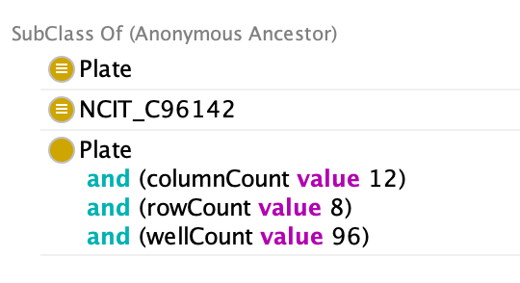
Example: Standard 96 Well Plate
Plate
SLAS 4-2004
96 Well Plate
“Things with height between 13.5mm and 15.25mm”
SLAS 4-2004 class (light blue) defines standard well layout (rows and columns).
Green node is a Restriction that specifies allowable values for the height of Standard 96 Well plates.
Standard 96 Well Plate
Class: cont:Standard96WellPlate
EquivalentTo:
cont:Plate
cont:SLAS_4-2004_96_Well_Plate
and (cont:height some
((om2:hasDimension value om2:millimetre)
and (om2:hasNumericalValue some
xsd:decimal[>= 13.5 , <= 15.25])))
Classification Inferences:

Slide 7

OWL Examples
For the container ontology

Slide 8
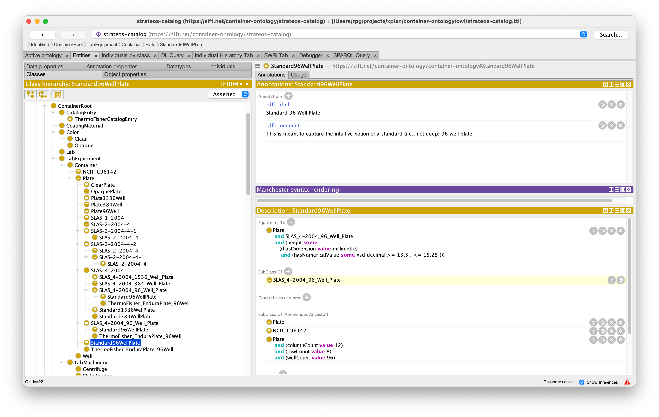
Protégé is the Most Commonly-Used OWL Ontology Editor

Slide 9
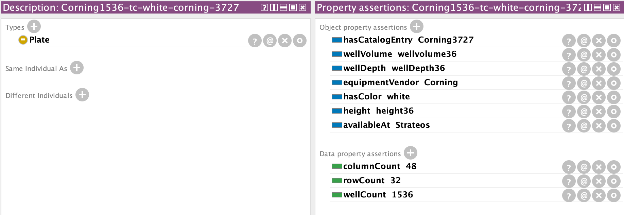
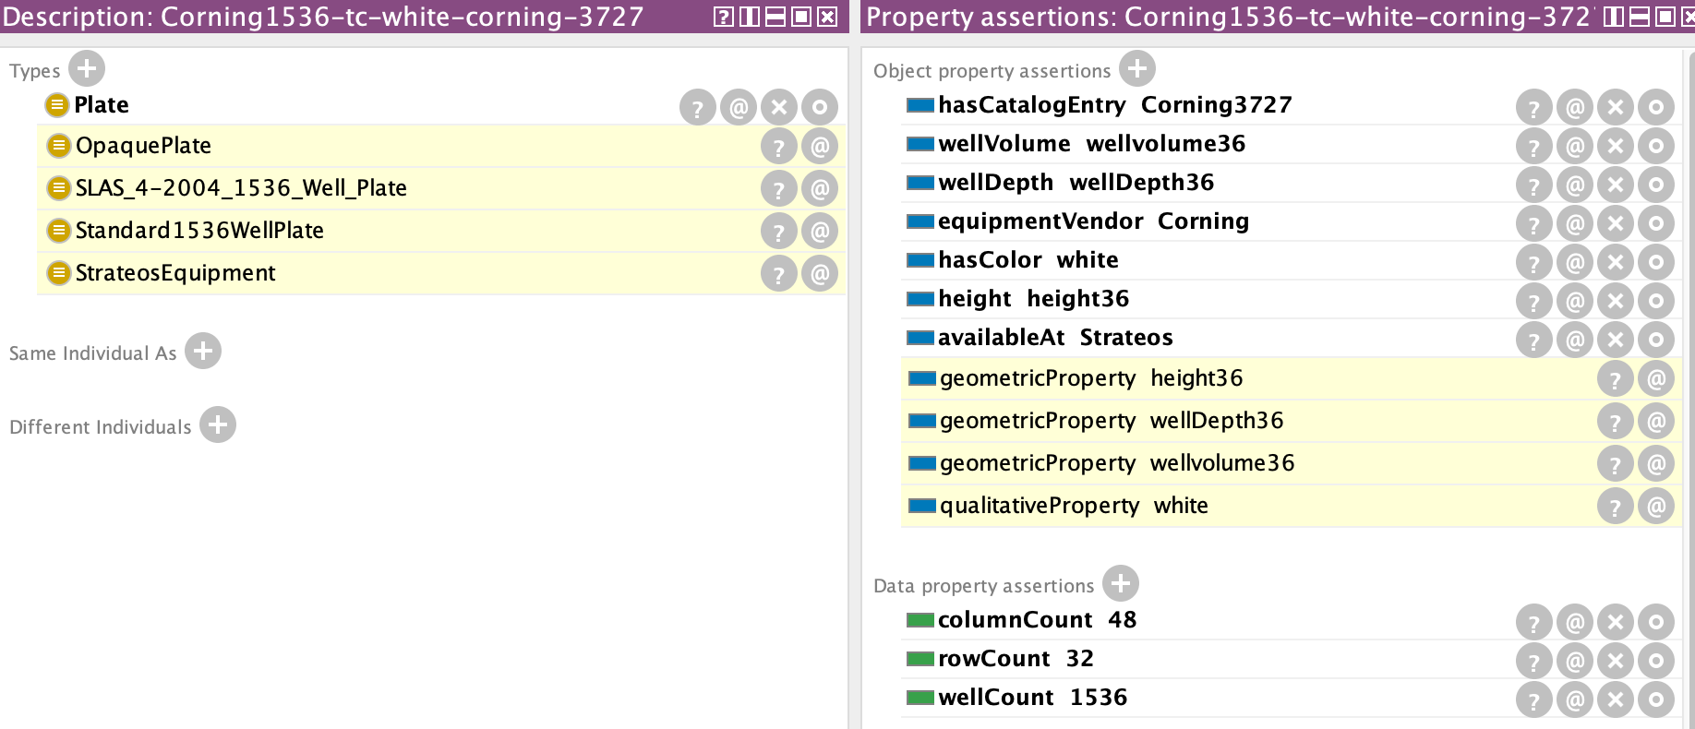
Classifying Objects
Input description of plate from Strateos catalog
Now we know that this plate is suitable if we ask for an opaque standard 1536 well plate that is available at Strateos.
Classification of plate.

Slide 10
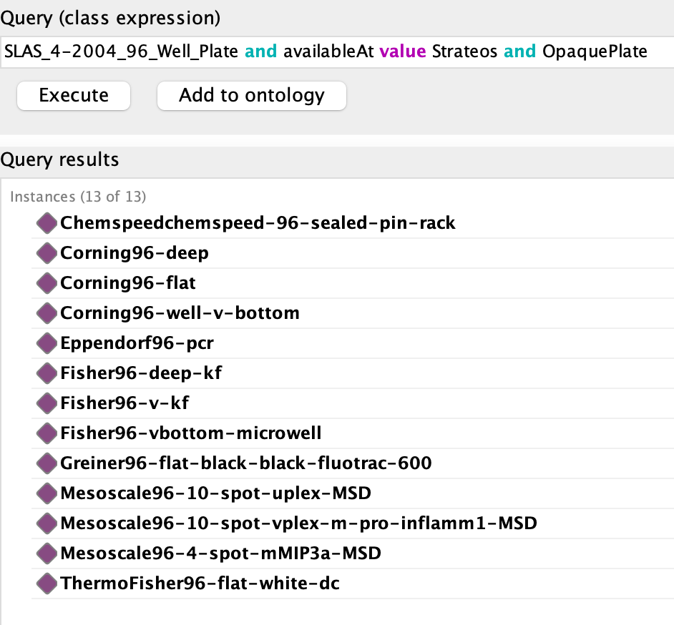
Finding Containers

Slide 11
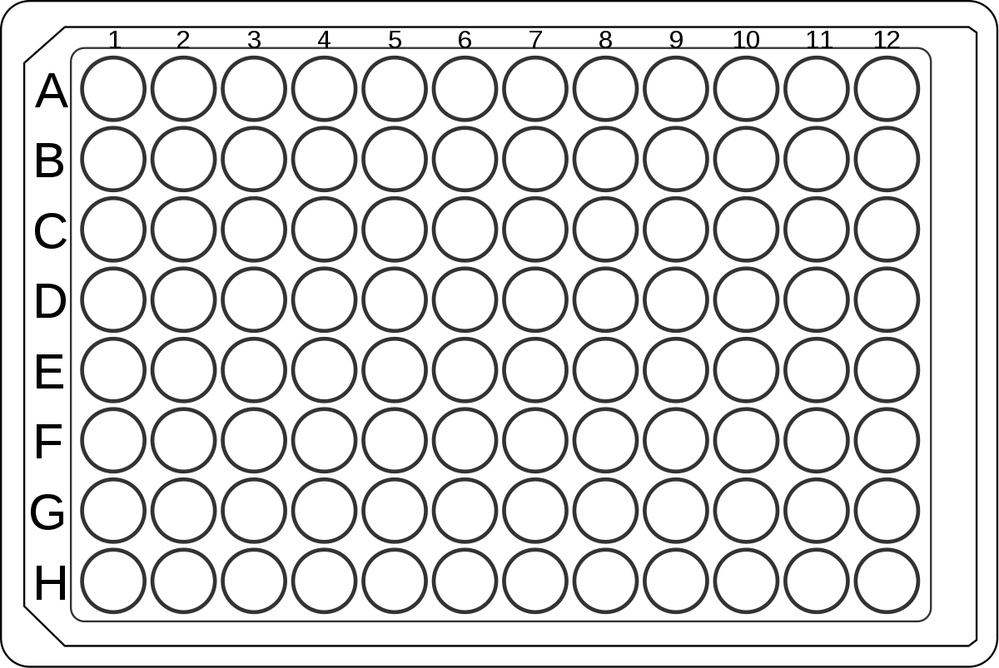
Structure of the Container Ontology

Slide 12
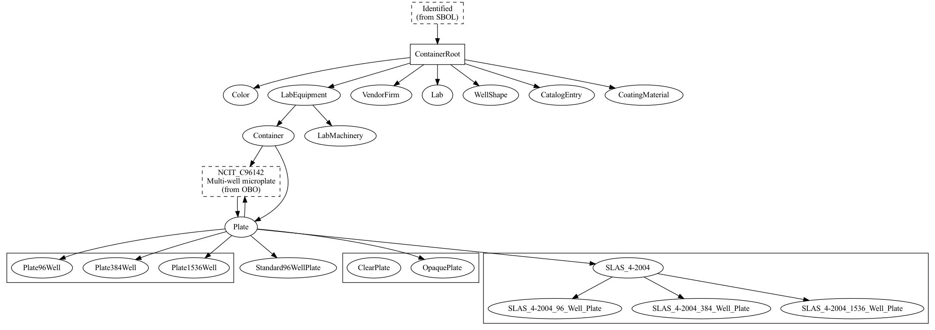
Fundamental classes
Connect to SBOL ontology – necessary?
For property values
Number of wells
Standard row/column layout
Clear vs. Opaque

Slide 13
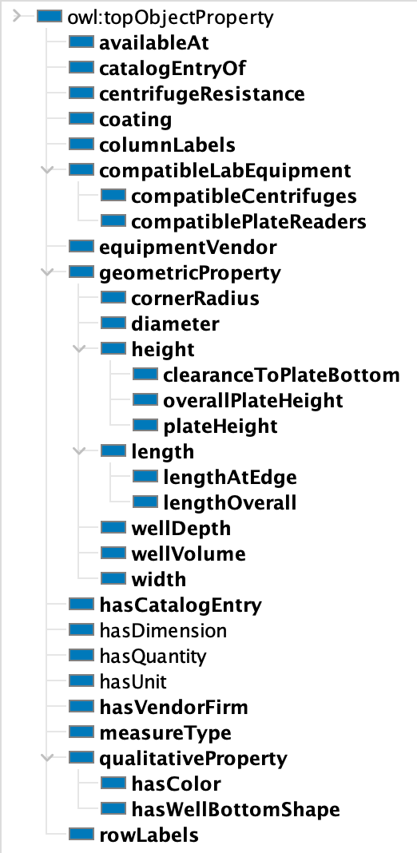
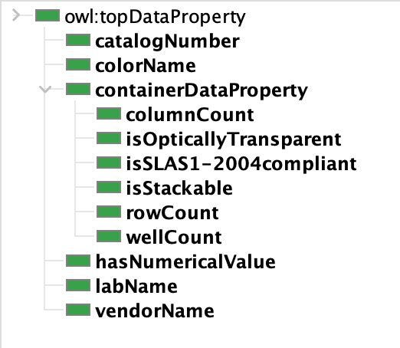
Key Microplate Properties for Classification
Object Properties
Data Properties

Slide 14
Classes and properties were chosen in consultation with a very small sample of practitioners. They undoubtedly need more work.
Which are the first additional directions to go when extending the ontology?
More containers, beyond microplates?
What properties are critical for determining suitability of microplates?

Slide 15
Using the Container Ontology Server

Slide 16





Expected Use Pattern (Tentative!)
Container
Ontology
OpenAPI Interface
PAML-based tools
Container API
Container Server
Queries
Local databases
(optional)
Local
Extensions
Web Browser

Slide 17
How to Use Today
Clone the Container ontology from GitHub
Start the server using the Makefile ( make server )
Use the OpenAPI interface to explore (🙁 – not user friendly)
Install the Python API
pip install ./container-ontology
Must be local install; not on PyPI (yet).
Run test example
server must be running
python –m container-api
More details in README on GitHub

Slide 18
Questions?
Suggestions?
Corrections?

